Slide 1




Deep Learning for QA
Thomas Klapwijk

Slide 2
Outline
The Problem
Datasets
Literature review --Current methods
Proposed methods

Slide 3
The Problem Modelling question answering (QA) using modern deep learning toolkits. This assignment will focus on using information retrieval-based (IR) systems to deduce an answer to the given question.

Slide 4
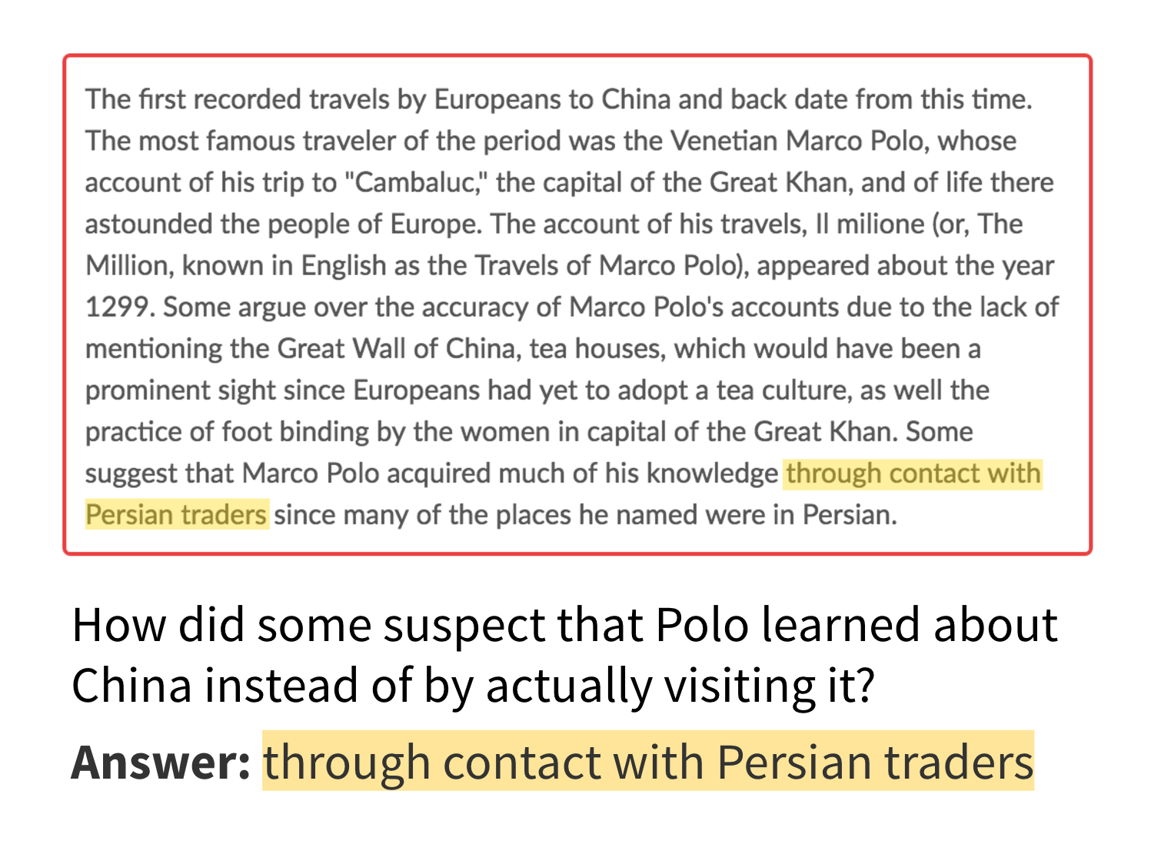
An Example
The given question is sent for question processing to extract the query. This query is sent to an IR engine for document and passage retrieval. The answer is commonly modeled using span labeling; as in the image [1].

Slide 5
Key Datasets
WebQuestions QA Benchmarking Dataset [2]. Contains training and tests data. Curated by Stanford university.
The Stanford Question Answering Dataset SQuaD. [3]. Curated by crowd workers on Wikipedia.
bAbl [4]. End-to-end dialog system dataset.

Slide 6
Review of existing approaches Several existing approaches exist:
Semantic approach; process question type and definitions in order to gain a semantic representation [5].
Memory Networks; inference components to reason over information
Dynamic Memory Networks; multiple passes over information

Slide 7
What are the current approaches for this problem
Semantic; probabilistic and temporal inferences.
Memory networks; mapping inputs to answers stored in memory
Dynamic memory networks; improving on memory networks through attention mechanisms.

Slide 8
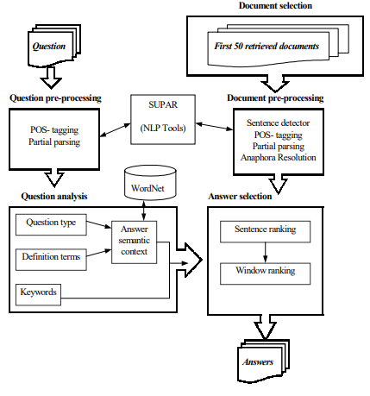
Semantic
Keywords are selected to help potential answer sources
Part-of-speech-tagging
Question type detection by analysing Wh-terms mapped in to categories:
PERSON, GROUP, LOCATION, TIME, QUANTITY, REASON, MANNER, NONE
Answer selection on:
Sentence-score = Keyword_idf_sum + (0.65 * Expanded_keyword_idf_sum)
Window-score = Sentence-score * (1+cos(Question_SC,Window_SC))

Slide 9
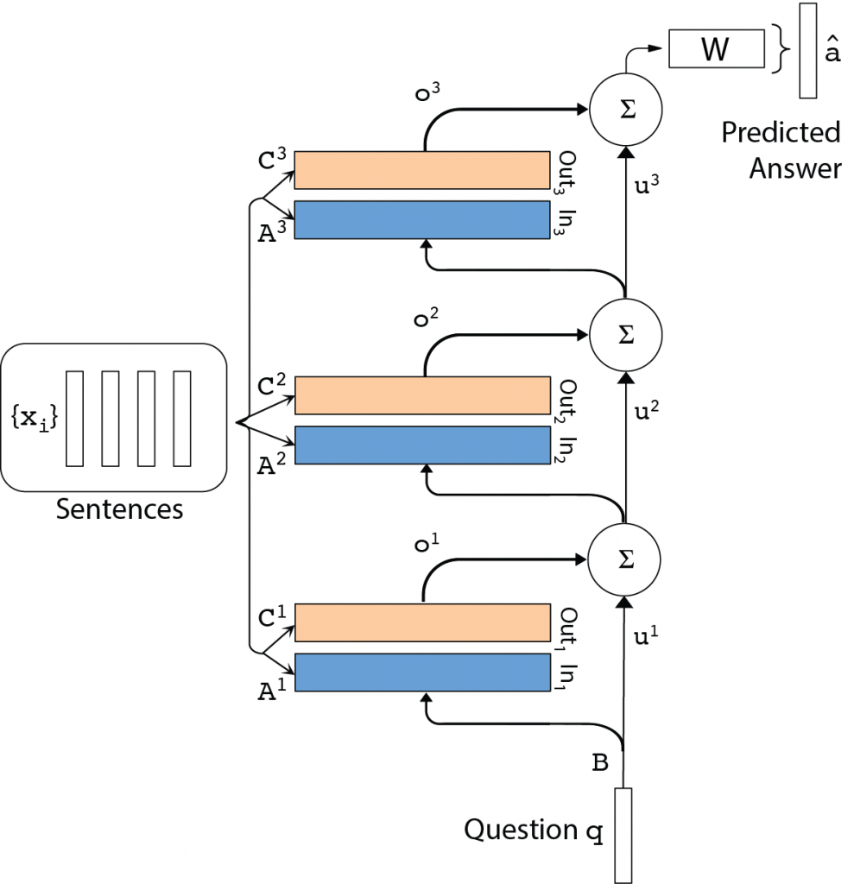
Memory Networks
Map questions to answers stored in memory.
Single pass in memory before providing an answer
Provide one word answer
Input accepts word vectors and outputs hidden states for each sentence

Slide 10
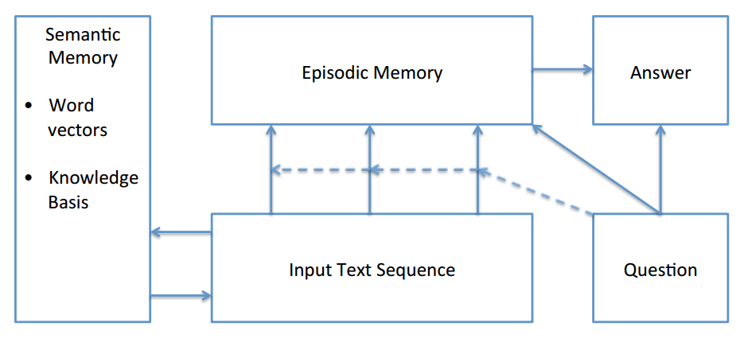
Dynamic Memory Networks
Provide more efficient answers; longer
Multiple passes of the memory before answering
Picks relevant facts from a database by using an episodic memory module
Parses input “story” and considers each sentences as a fact

Slide 11
Solution Proposal This project will implement a dynamic memory networks and investigate avenues of improvement in both the network itself and pre-processing of the dataset

Slide 12
Solution description
Use TensorFlow to implement a dynamic memory network.
Investigate implementing a semantic memory to the network to aid in forming more relationships between words; using GloVe: Global Vectors for Word Representation [7].
Train the network using bAbI and WebQuestions.

Slide 13
Why it’s better than existing solutions
Unless adequate pre-training is done on the data or if the implementation does not consider the cosine similarity between two word vectors, then low accuracy will be observed in the system. This research will investigate adding this understanding to the network.

Slide 14
Questions?

Slide 15
References
[1] P. Rajpurkar, "The Stanford Question Answering Dataset", mlx, 2019. [Online]. Available: https://rajpurkar.github.io/mlx/qa-and-squad/.
[2] "brmson/dataset-factoid-webquestions", GitHub, 2019. [Online]. Available: https://github.com/brmson/dataset-factoid-webquestions
[3] "The Stanford Question Answering Dataset", Rajpurkar.github.io, 2019. [Online]. Available: https://rajpurkar.github.io/SQuAD-explorer/.
[4] "bAbI - Facebook Research", Facebook Research, 2019. [Online]. Available: https://research.fb.com/downloads/babi/.
[5] J. Luis, A semantic approach to Question Answering systems. Universidad de Alicante.

Slide 16
References (continued)
[6] J. Pennington, "GloVe: Global Vectors for Word Representation", Nlp.stanford.edu, 2019. [Online]. Available: https://nlp.stanford.edu/projects/glove/.

